Slide 1
Processing Data

Slide 2
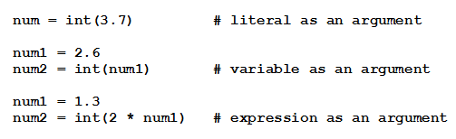
Built-in Functions
Output of functions is a single value
Function is said to return its output
Items inside parentheses called arguments
Examples:

Slide 3

Reading Text Files
Establish connection between the program and the file
File is said to be opened for input
Read lines of file in a loop
for line in infile:
listvar.append(line.rstrip()
Or using list comprehension:

Slide 4
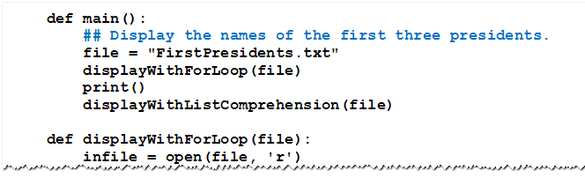
Reading Text Files
Example 1: Three lines of the file FirstPresidents.txt contain names of first three U.S. presidents.
Program shows two ways to display the contents

Slide 5
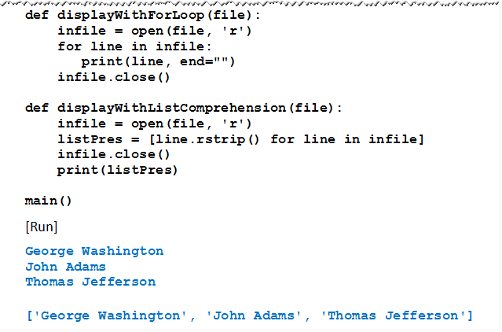
Reading Text Files
Example 1:

Slide 6


Reading Text Files
Places entire contents of file (including the newline characters) into single string.
Current line is assigned to strVar and pointer advances to end of that line
Method returns the empty string after all lines have been read

Slide 7
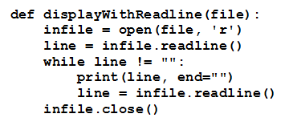
Reading Text Files
Given function displayWithReadline

Slide 8
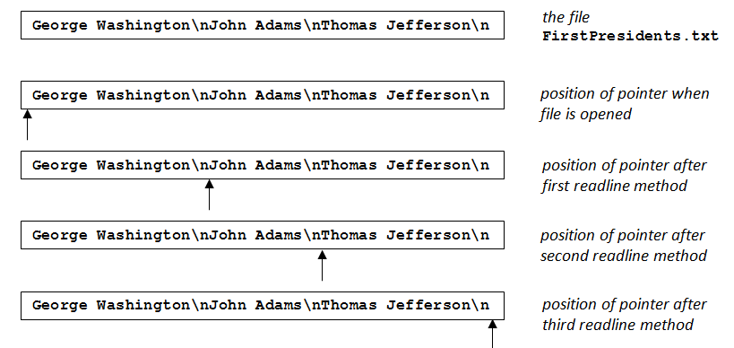
Reading Text Files
FIGURE 5.1 Pointer positions during the execution of the displayWithReadline function

Slide 9


Creating Text Files
Creates a new text file with the specified name
Said to be opened for writing
Adds the value of strVar as a line of the file
File must be closed to guarantee that all data has been physically transferred to the disk.

Slide 10
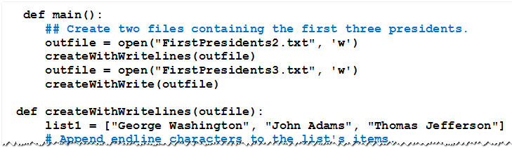
Creating Text Files
Example 2: Program shows two ways to create files identical to FirstPresidents.txt.

Slide 11
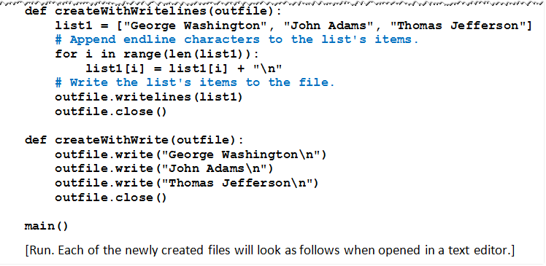

Creating Text Files
Example 2:

Slide 12
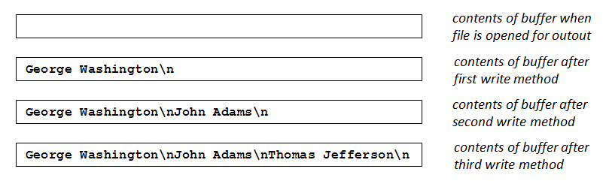
Creating Text Files
FIGURE 5.2 Contents of the buffer after execution of the second open statement and the createWithWrite function in Example 2

Slide 13
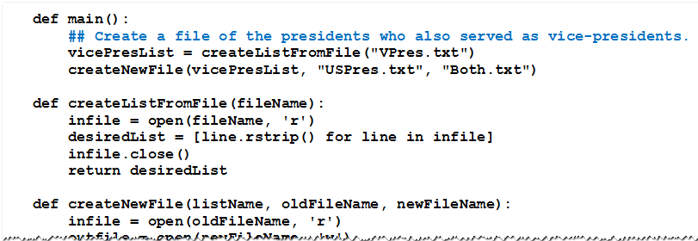
Creating Text Files
Example 4: Program creates a file named Both.txt containing the names of the presidents who also served as vice president.

Slide 14
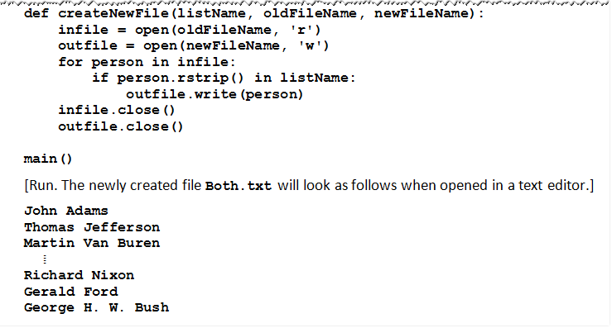
Creating Text Files
Example 4:

Slide 15
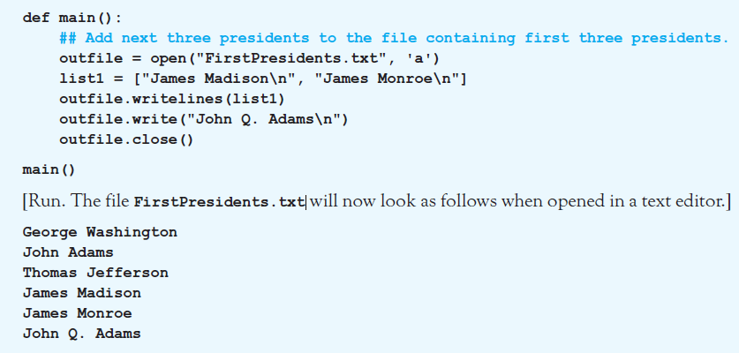
Adding Lines to an Existing Text File
Example 5: Program adds 3 more names to file. Uses open statement with ‘a’ parameter.

Slide 16
Altering Items in a Text File
Altering, inserting, or deleting a line of a text file
Cannot be made directly
New file must be created
Read each item from the original file
Record it, with changes, into new file
Old file is then erased
New file is renamed with name of the original

Slide 17



Altering Items in a Text File
Functions needed for these tasks must be imported from standard library module os
To remove a file
To rename a file

Slide 18
Sets
A list is an ordered collection of items
Possibly with repetitions
Delimited with [ ]
A set is an unordered collection of items
No duplicates
Delimited with { }

Slide 19
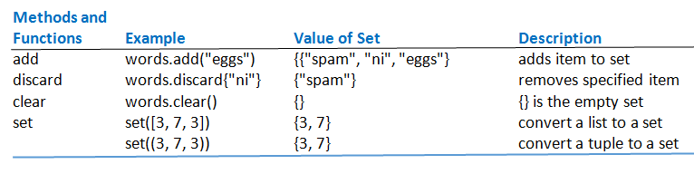
Sets
Table 5.1 Set methods (words = {"spam", "ni"})

Slide 20
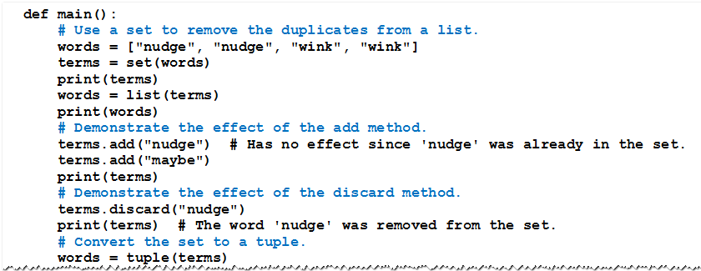
Sets
Example 6: Program illustrates set operations.

Slide 21
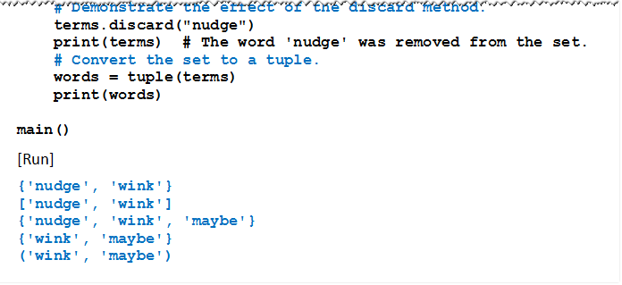
Sets
Example 6: Program illustrates set operations.

Slide 22

Set Comprehension
Sets can be created with comprehension
This command creates the set {0, 1, 4, 9}.

Slide 23

Set-theoretic Methods
Methods that create new sets from two existing sets
Merge two sets
Intersection of two sets
Set difference

Slide 24
Using Set-theoretic Methods with Files
Steps for extracting information from two related text files
Create two sets; each containing the contents of one of the two text files.
Apply a set operation such as union, intersection, or difference to the sets.
Write the resulting set into a new text file.

Slide 25
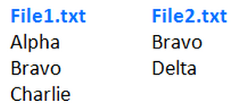
Using Set-theoretic Methods with Files
Example 7: Program demonstrates the use of the three set-theoretic operations with two simple text files
Contents are shown below

Slide 26
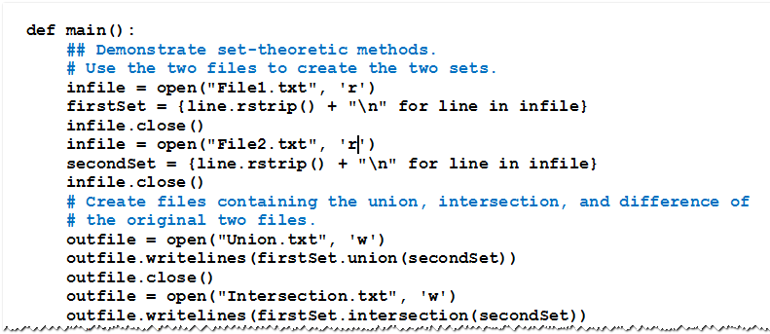
Using Set-theoretic Methods with Files
Example 7

Slide 27
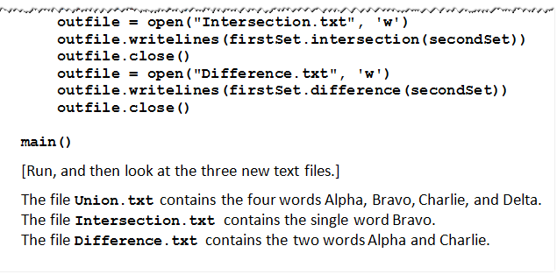
Using Set-theoretic Methods with Files
Example 7

Slide 28
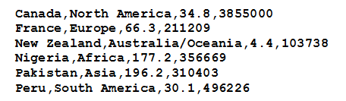
CSV Files
Text files considered so far had a single piece of data per line
Consider CSV formatted file
Several items of data on each line
Items separated by commas.

Slide 29
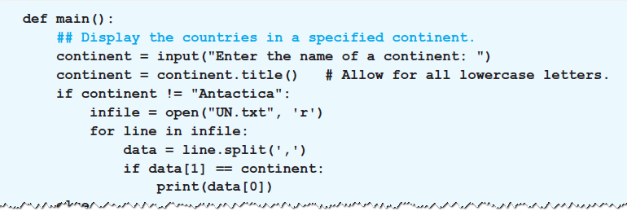

Accessing the Data in a CSV File
The split method is used to access the fields
Example 1 : Program requests name of a continent
then displays names of UN member countries

Slide 30
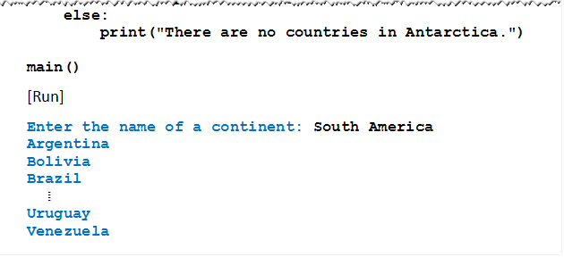
Accessing the Data in a CSV File
Example 1 : Program requests name of a continent
then displays names of UN member countries

Slide 31
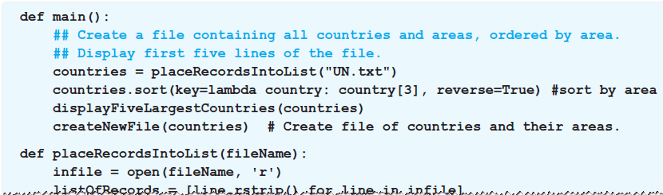
Analyzing the Data in a CSV File with a List
Data can be analyzed by placing data into a list
Items of the list are other lists
Holding the contents of a single line of the file
Example 2: Program places contents of file into a list of 193 items

Slide 32
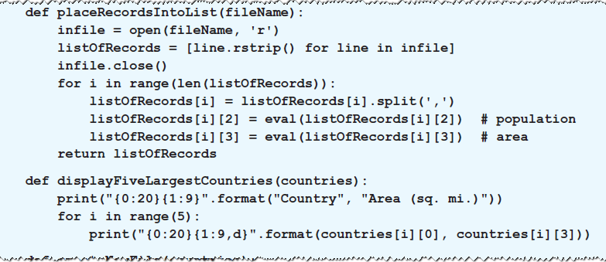
Analyzing the Data in a CSV File with a List
Example 2: Program places contents of file into a list of 193 items

Slide 33
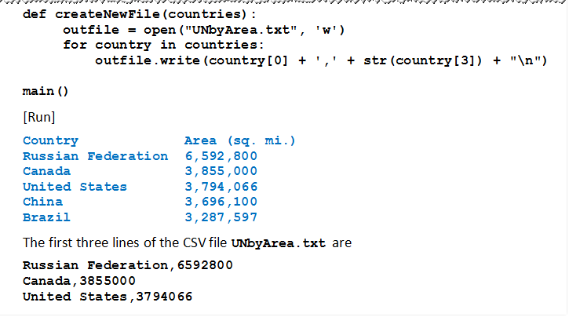
Analyzing the Data in a CSV File with a List
Example 2:

Slide 34
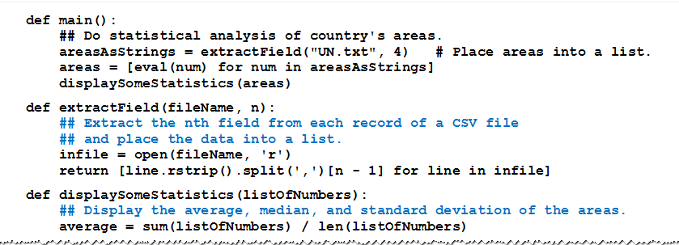
Analyzing Numeric Data
Example 3: Program does statistical analysis of areas of countries in United Nations.

Slide 35
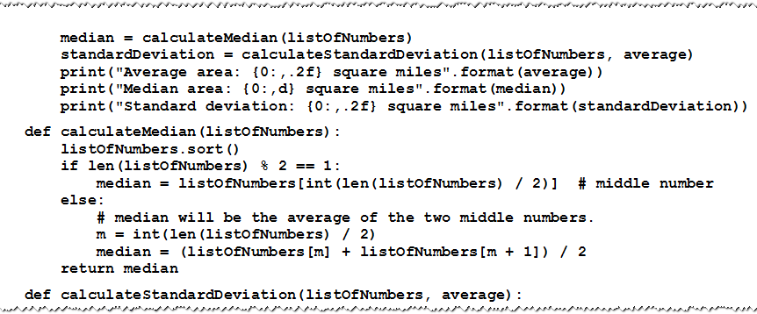
Analyzing Numeric Data
Example 3: Program does statistical analysis of areas of countries in United Nations.

Slide 36
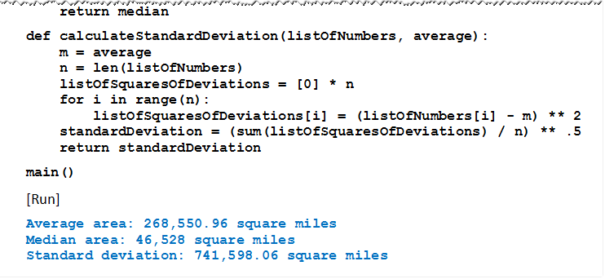
Analyzing Numeric Data
Example 3: Program does statistical analysis of areas of countries in United Nations.

Slide 37
END

